Slide 1
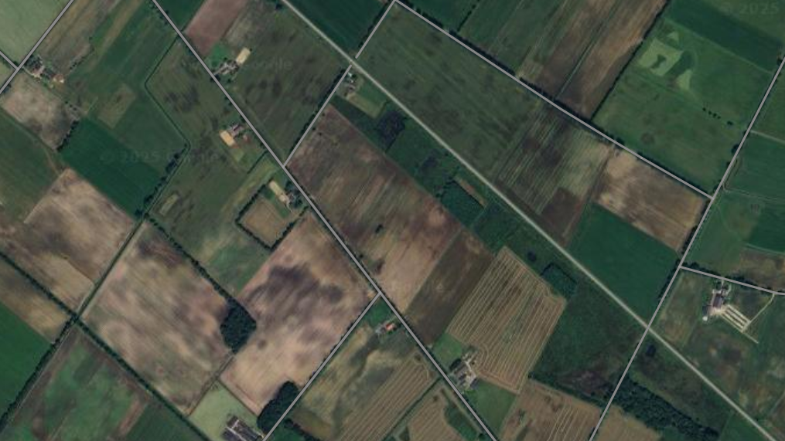
EcoHance: Improving biodiversity through ESG off-setting
Using a collaborative platform to empower landowners in enhancing biodiversity on their properties
January 2025

Slide 2
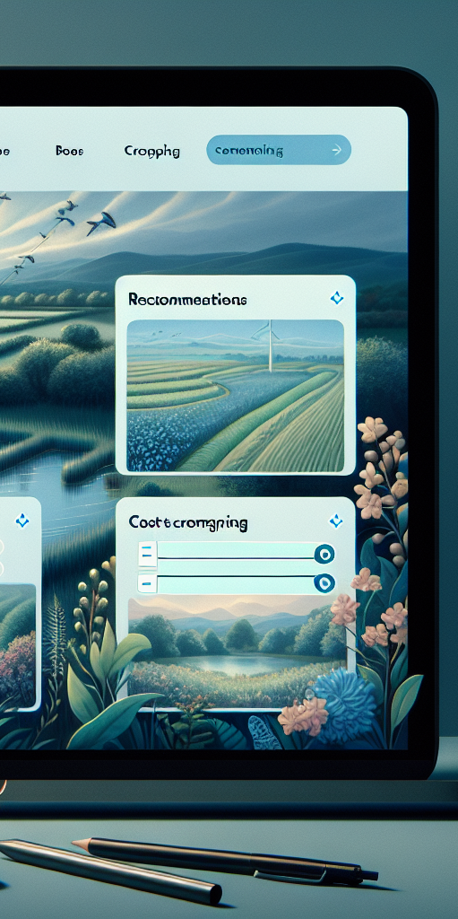


The EcoHance Platform for biodiversity off-setting
By using this platform, landowners can improve their land to increase biodiversity, with financial contributors providing funding for emissions reporting. Local neighbors contribute to local biodiversity while receiving financial compensation to enhance their environment
Logging in
Landowner
Land owners
Financial contributors
Stichting Steenbreek
Financial contributors
Neighbors & community

Slide 3
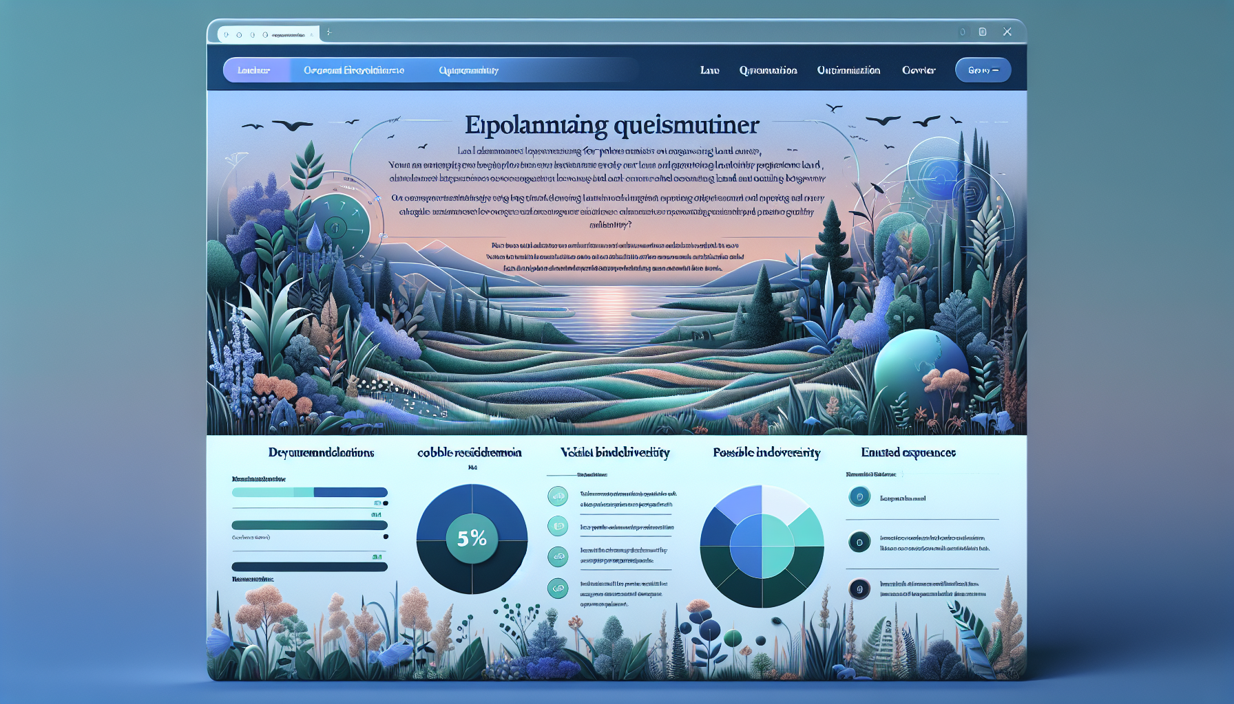
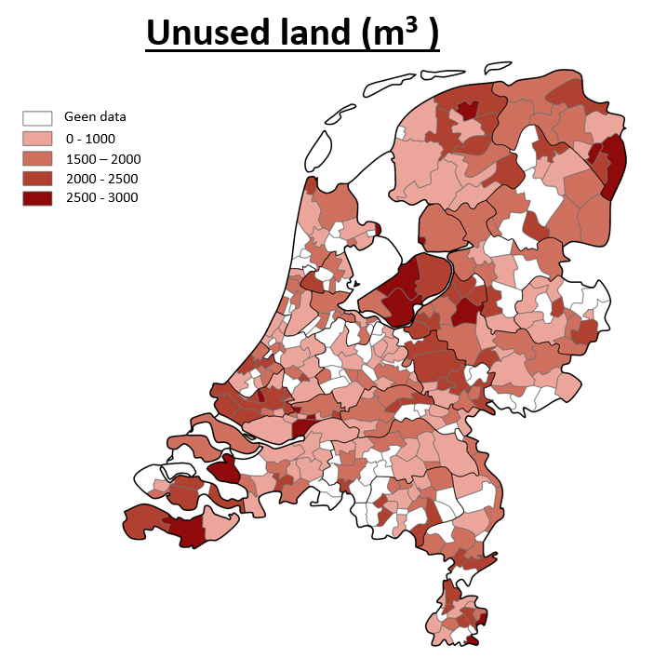





Monetization of biodiversity improvements
Organisations are increasingly looking for opportunities to off-set unsustainable business activities. Our biodiversity improvements model calculates a monetary value for this off-setting, based on global nature financial disclosure standards
Required data
Recommended initiatives
Data analysis
Data sources used
Advanced data analysis identifies the best farms for land leasing, with farmers actively approached.
Biodiversity improvement
Expected change in key impact drivers
1 | Species richness, abundance and diversity
2 | Habitat quality
3 | Carbon storage, water purification, and pollination
Generative AI engine based on Global Natural Capital Accounting Standards¹
Community impact
Monetary value and costs

Slide 4
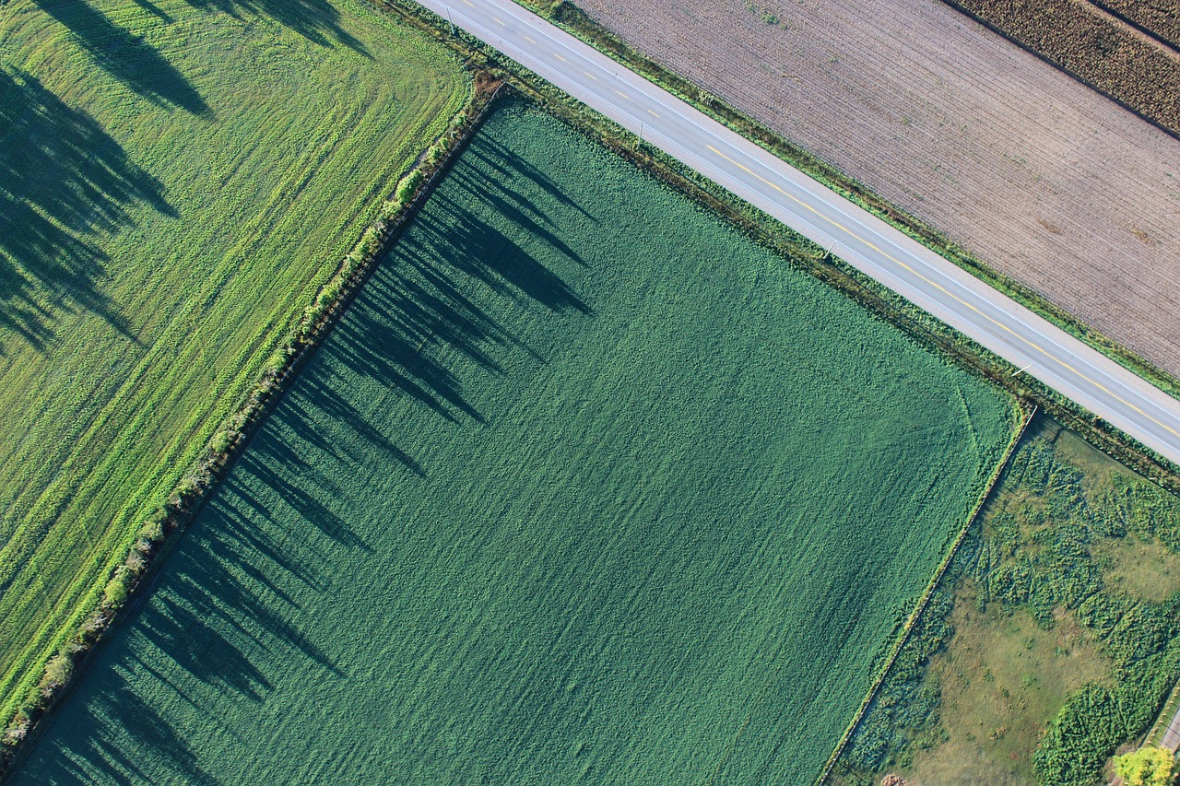



In-depth features for rural landowners
Registering to make land available for biodiversity enhancement by completing a questionnaire
Lease your land
Squares of land
Information about conditions
+ Financial compensation
+ Better harvest through biodiversity
Price
Square
Biodiversity points

Slide 5


In-depth features for financial contributors
Supporting as a contributor by providing funding to enhance biodiversity and increase emission rights for companies and the public sector
Initiative Bee park Location: Drenthe
Price: 1500 EUR
Score: 30%
Investments
Wildife corridors Location: Friesland
Price: 700 EUR
Score: 15 %
+ Improved ESG reports and sustainability commitment
Wetland restoration Location: Flevopolder
Price: 1200 EUR
Score: 35 %

Slide 6

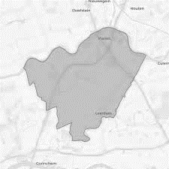
In-depth features for neighbours & community
Supporting as a neighbor by contributing to land improvement and investing in the biodiversity of the environment, along with financial support for local enhancements
Search here
Time
Effort
+ Earn local points
+ Improved wellbeing
Three initiatives found!
Project A: Build a Beehive
Project B: Fishing corridor
Project C: Planting trees

